Slide 1
SOFTWARE DEVELOPMENT 3
Serialization

Slide 2
Serialization
The process of storing and retrieving objects in an external file is called serialization.
Serialization allows you to take any object that implements the Serializable interface and turn it into a sequence of bytes that can be later fully restored to regenerate the original object. Allows you to implement persistence, i.e. the object lives outside the program.
Writing an object to a file is referred to as serializing an object and reading an object from a file is called deserializing an object.
To implement the Serializable interface for a class, you need only declare that the class implements the interface and that all the fields in the class (primitives and/or class types) are themselves Serializable, including all superclasses.
The Serializable interface has no methods to implement.

Slide 3
ObjectInputStream & ObjectOutputStream
Two classes from the java.io package are used for serialization
The output process for objects is managed by an object of the class ObjectOutputStream
The input process is handled by an object of the class ObjectInputStream.
The constructor for the ObjectOutputStream class requires a OutputStream object as an argument that defines the stream for the file where you intend to store your objects.

Slide 4
Example
FileOutputStream output = new FileOutputStream("MyFile");
ObjectOutputStream objectOut = new ObjectOutputStream(output);
To write an object to the file, MyFile, you call the writeObject () method of ObjectOutputStream with the object as the argument
Since this method accepts an object of type Object as an argument, you can pass an object of any class to the method
If myObject is an instance of a public class that implements the Serializable interface, then to write myObject to the stream that we defined above, you would use the statement:
objectOut.writeObject(myObject);
This takes care of writing to the stream everything necessary to reconstitute the object later in a read operation. This includes information about the class and all its superclasses, as well as the contents and types of the data members of the class.

Slide 5
ObjectInputStream
To read an object from a file, wrap a FileInputStream inside an ObjectInputStream and call readObject()
FileInputStream input = new FileInputStream("MyFile");
ObjectInputStream objectIn = new ObjectInputStream(input);
objectIn.readObject(myObject);
What is returned is a reference to an Object so you must cast it into the appropriate object type that you are retrieving
Car c;
c = (Car) objectIn.readObject();

Slide 6
Controlling Serialization
If you have security issues you may not want to serialize portions of your object, sensitive data, e.g. passwords etc., once data is serialized to a file or sent across a network it is possible for someone to access it.
To control this you can turn off serialization on a field by field basis using the “transient” keyword, which means that the particular field marked as transient will not be saved.

Slide 7
Transient
Declaring a field as transient:
public class Logon implements Serializable
{
private String userName;
private transient String password;
// transient class member
// Rest of class definition
}
Declaring the data member as transient will prevent the writeObject () method from attempting to write the data member to the stream
The rest of the class is ordinary and serialized automatically. However the password is transient so is not written to disk, also when reading the data back in there is no attempt to recover the password. When the object is recovered the password field will be null

Slide 8
Serialization Example
The following is an example which creates 2 car objects (a Ford Galaxy and an Opel Corsa), stores them in a file and then retrieves them from the file.

Slide 9
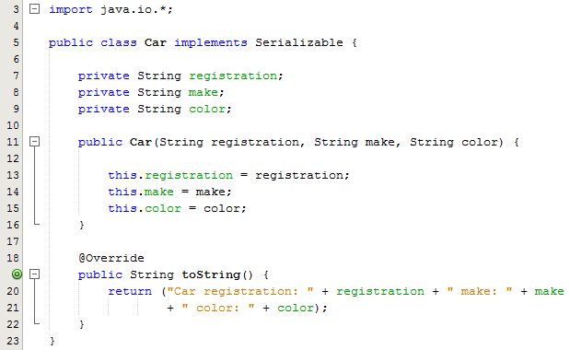
Serialization Example Part 1/3
On line 5 we have implemented the Serializable interface
No need to override any methods

Slide 10
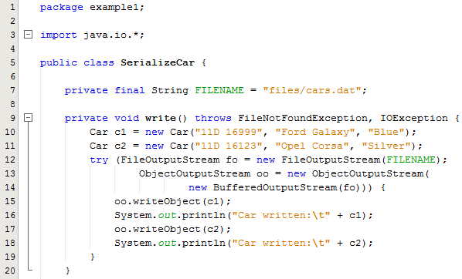
Serialization Example Part 2/3
Note the use of the BufferedOutputStream class: this provides buffering to your output streams. Buffering can speed up IO quite a bit.
Rather than write one byte at a time to the network or disk, you write a larger block at a time. This is typically much faster, especially for disk access and larger data amounts.

Slide 11
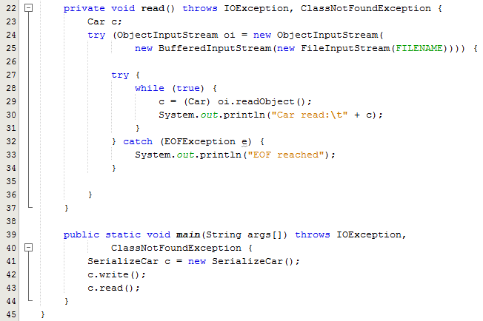
Serialization Example Part 3/3
Line 29: The readObject() method retrieves the next Object out of the stream and deserializes it. The return value is Object, so you will need to cast it to its appropriate data type.
Line 22,39:. If the JVM can't find a class during the deserialization of an object, it throws a ClassNotFoundException.

